Slide 1


PESTICIDE SPRINKLER WITH IOT BASED SECURITY
by
Bhoomika C P 4GW19EE005
Prakruthi K N 4GW19EE026
Rakshitha G 4GW19EE030
Vidyashree K 4GW19EE041
Under the Guidance of
Smt. SHILPASHRI V N
Assistant Professor
Dept. of EEE, GSSSIETW, Mysuru
Department of Electrical & Electronics Engineering

Slide 2
Overview
Introduction
Literature survey
Scope of project
Objectives
Methodology
Hardware & Software Description
Expected Outcome
References

Slide 3
Introduction
The rural population depends on agriculture. Aimed at increasing crop yield and reducing labor involved various kinds of agricultural robots have been proposed and developed.
It is programmed to carry out the required function. Robot has a sprayer equipped with sprinkler which is controlled by a relay.
The goal of agriculture robotic is more than just the application of robotic technologies to agriculture.
The adverse effects of pesticides can be prevented.

Slide 4
Literature Review
An Attempt to Develop an IOT based Vehicle Security System -This paper provides a comparative analysis of the ESP32 with some other market competitors and introduces the microcontroller specification, features and programming details. A portable, wireless oscilloscope based on the ESP-WROOM-32 and a mobile application is described in detail as an example of successful practical implementation of the device.
Design and Implementation of Remote Operated Spy Robot Control System - Spy robots are the remotely controlled robots , equipped with a wireless camera, an antenna , batteries and four movable wheels. Two different PICs are used to remotely control of the wireless system and also to control the spy robot.
Microcontroller Based Security System With Intruder Position – The microcontroller based security system with Intruder Position Display is a design , that applies automated security system. The sensors will receive the signal when the intruder is around , while the control program will translate the received signal from sensor to useful information about function of the system.

Slide 5
Scope of Project
Fast operation because RISC architecture embedded chip is used.
Used in farms and fields.
Maintain public properties and parks.
This Agribot can be a multi-functional device used in sanitizing without personal contact.
Provides Agricultural security.

Slide 6
Objectives
To spray pesticides effectively on the land by sitting at one place.
To implement the IOT system in agriculture.
To speed up the pesticides spraying operation.
Ensuring safety of the system.

Slide 7
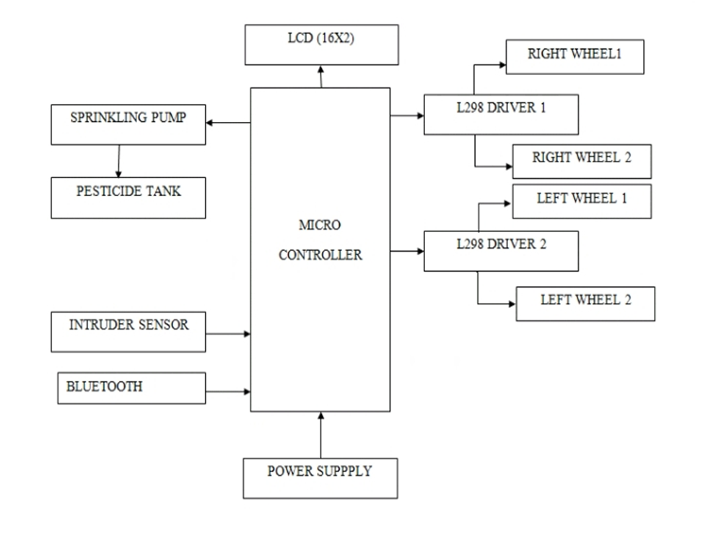
Methodology

Slide 8
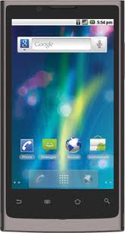

PESTICIDE CONTROL SECTION

Slide 9
The robot is placed in the farm and is switched on through IOT and its direction controlled by Android application.
The spraying of pesticides which can be done with the help of pesticide sprinkling pump and is periodically sprayed whenever the relay switch is on.
The system focused on the design, development and the fabrication of the agricultural robot with pesticide spraying system in addition to security system using IOT.

Slide 10
Hardware & Software Description
HARDWARE COMPONENTS
P89V51RD2 Microcontroller
Pesticide Sprinkler
Pesticide Tank
DC Driving Motors
Intruder sensor
DC Motors
Bluetooth

Slide 11
SOFTWARE COMPONENTS
Arduino IDE
Embedded C

Slide 12
EXPECTED OUTCOME
The constructed pesticide sprayer can travel on rough surfaces in the field and sustain enough load of other equipments.
To decrease the work load on the farmers and the severe health problems faced by them .

Slide 13
REFERENCE
Tahesin Attar, Prajakta Chavan, Vidhi Patel, Megha Gupta, Debajyoti Mukhopadhyay, “An Attempt to Develop an IOT based Vehicle Security System” , 2018, IEEE International Symposium on Smart Electronic Systems (iSES) (Formerly iNiS).
Shahajada Mahmudul Hasan, Syed Mamun R Rasid, Avijit Mallik, Md. Rokunuzzaman, “Development of a Wireless Surveillance Robot for Controlling from Long Distance”, International Journal of Engineering Research and Management(IJERM), ISSN: 2349- 2058, Volume-05, Issue-09, September 2018.
Mr. V. Gowrishankar, Dr. K. Venkatachalam, “GRD Journals- Global Research and Development Journal for Engineering”, Volume 3, Issue 5, April 2018.
Prathibha S R, Anupama Hongal, Jyothi M P, “IOT Based Monitoring System in Smart Agriculture”, 2017, International Conference on Recent Advances in Electronics and Communication Technology.
Priyanka Yadav, Leena Chaudhari, Swati Gawhale, “War Field Spying Robot with Wireless Night Vision Camera”, International Journal for Research in Applied Science & Engineering Technology(IJRASET), 2017.

Slide 14
S Mahendra Kumar and T Guna Sekar, “Cross-Layer Design for Energy Efficient Multicast Video Transmission over Mobile Ad Hoc Networks”, Asian Journal of Research in Social Sciences and Humanities, Volume 6, Issue 9, Pages 719-734, 2016
V Gowrishankar, K Venkatachalam, “Survey on Performance Analysis of Data Converters for Sensor Network Applications”, Vol. 6, Issue 8, 2016.
H. L. Kushwaha, J. P. Sinha, T. K. Khura, Dilip Kumar Kushwaha, Uttpal Ekka, Mayank Purushottam and Nishtha Singh ,“Status and Scope of Robotics in Agriculture”, International Conference on Emerging Technologies in Agricultural and Food Engineering ,30th December, 2016.
Ashish Lalwani, mrunmai Bhide, S. K. Shah, “ A Review:Autonomous Agribot for Smart Farming”, 46th IRF International Conference, 2015.

Slide 15


